Slide 1
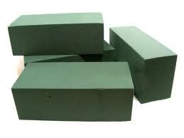
Floral Foam
Soaks up water like a sponge and acts both as a preservative to prolong the life of the flowers and a support to hold them in place.
Notes:
F

Slide 2
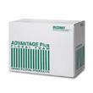
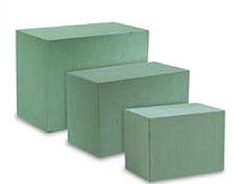
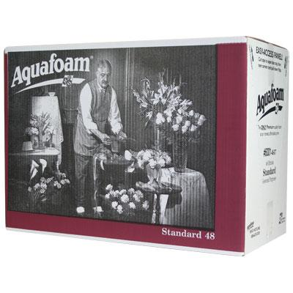
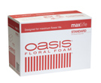
Floral Bricks/Blocks
Come in regular size bricks
Foam Blocks are larger and
available in 3 sizes

Slide 3
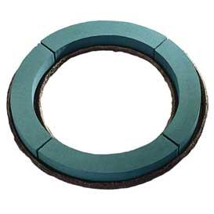
Foam Wreaths-mache
Provides a water source for flowers and holds securely
Available in:
12", 18", 22", 24" Wreaths
Perfect for sympathy, weddings, parties,
anniversaries and more.

Slide 4
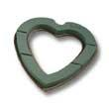
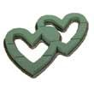
Foam Open Hearts
Provides a water source for flowers and
holds securely
Available in:
12",18", 24" Open Heart
26" Open Double Heart

Slide 5
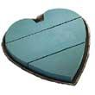
Foam Solid Hearts
Provides a water source for flowers and holds securely
Available in:
12", 18", 24" Solid Heart

Slide 6
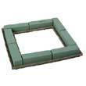
Foam Open Squares
Provides a water source for flowers and holds securely
Available in:
18" square

Slide 7
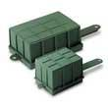
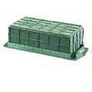
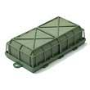
Foam Easel Cages
Used to arrange flowers to go on a easil stand
Primarily for funeral flowers
Provides a water source for flower
And holds securely

Slide 8
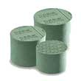
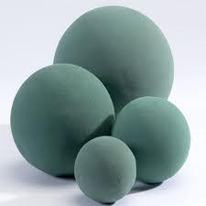
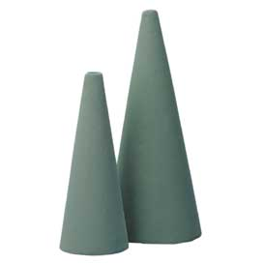
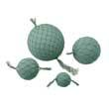
Foam Spheres/Shapes
Foam shapes are available in several convenient shapes to help make arranging flowers into these shapes easy and time saving for our customers.

Slide 9
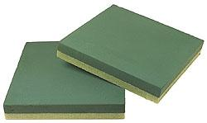
Foam Sculpting Sheet
Cut a distinctive shape for a personalized display, such as a monogram, or use an entire sheet for one large design
Styrofoam plastic foam base allows most arrangements to float in a pool or fountain

Slide 10
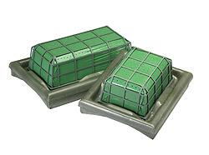
Foam Casket Saddles
Deluxe OASIS® Floral Foam Maxlife wrapped in green poly film to hold in moisture
Sturdy molded urethane base with scratch-guard rubber strips to hold in place.

Slide 11
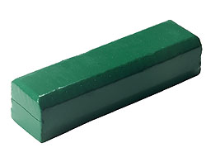
Spray Bar
Dry foam base allows for easy and secure attachment to easels or hooks
Flower stems easily pierce poly cover without tearing the film beyond point of insertion

Slide 12
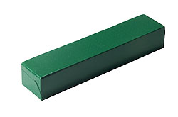
Raquettes
Rigid plastic base with two drilled holes provides flexibility for final display on mantels, altars, stages or other locations
Perfect for creating larger horizontal or vertical arrangements

Slide 13
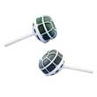
Foam Bridal Holders
OASIS® Floral Foam Maxlife-filled rounded cage optimizes the depth and dimension of the bouquet
• Available straight handle or traditional slant
• Use as a casket accent, in a bud vase, or in an Eiffel tower vase

Slide 14
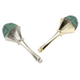
Elegant Bridal Holders
Produce beautiful bouquets days in advance with the OASIS® Floral Foam Maxlife water source and water-wicking system continuously delivering water to the flowers
Twist the bottom off set in water and let drink, when ready to use twist the bottom back on

Slide 15
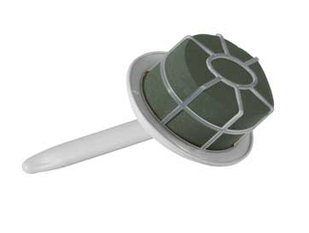
Luxe Bouquet Holder
Oval-shaped foam and handle position allow for even distribution of weight for balance
Sturdy cage provides extra security, Large design space - can accommodate over 2 dozen large-head roses

Slide 16
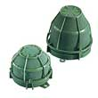
Iglu
Caged pieces with two side tabs allow for easy attachment to posts, candelabras, grapevine wreaths and more

Slide 17
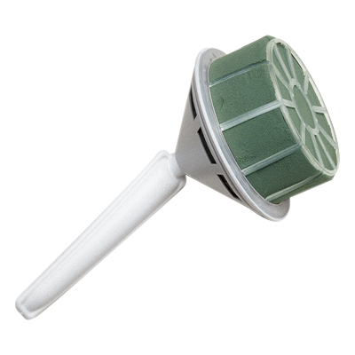
Aquafoam bouquet holders
Available in Ultra, standard, and petite
Comfort grip handles

Slide 18
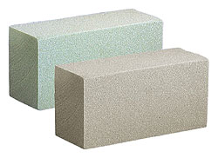
Sahara dry foam
SAHARA® Dry Foam is the answer for silk and dried arrangements when you want to ensure quality and consistency.

